Slide 1
How do you like your potatoes?

Slide 2
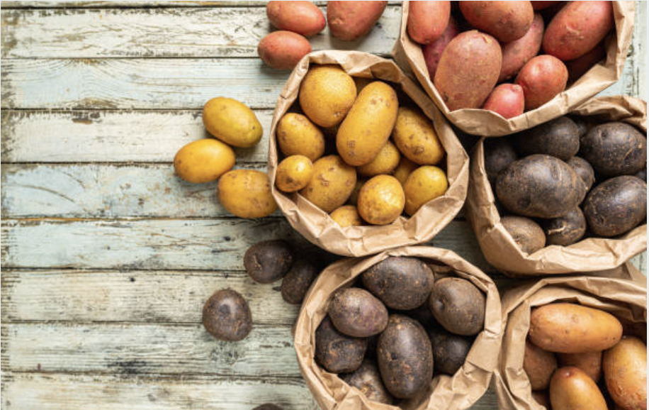
The Potato
From the Solanaceae family comes this favorite vegetable for all mankind. Whether to fry them, bake them or simply make it into a mush, The Potato is the one we pick out of the basket.
So we have taken as our mission to help the farmers to continue grow this wonderful vegetable and keep then as healthy as possible.

Slide 3
How to help the farmers?
The scope of this project is to predict disease conditions in a potato plant by analysing structural deformities in their leaves with the help of image recognition and build a website to do so. Could be later developed into a mobile App.

Slide 4
The Data

Slide 5
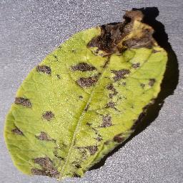
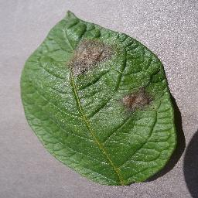
To keep the project simplified, we are sticking with just two disease conditions.
Early Blight
Late Blight
2.

Slide 6
Data Sets
We have collected 1000 images each for early and late blight and as control 152 images of completely healthy plants.
This dataset is available on Kaggle.

Slide 7
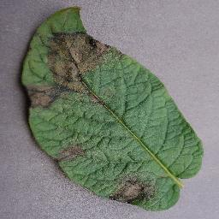
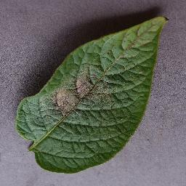
The Plan
Preprocessing
TF Dataset
Create Model
CNN
Build Website
Implement ML algorithm

Slide 8
Sit Rep
Currently on Preprocessing and cleaning
Have to implement a Model
https://github.com/Joachim0211/CNN-DiseaseDetectionOnPlantLeaves.git

Slide 9
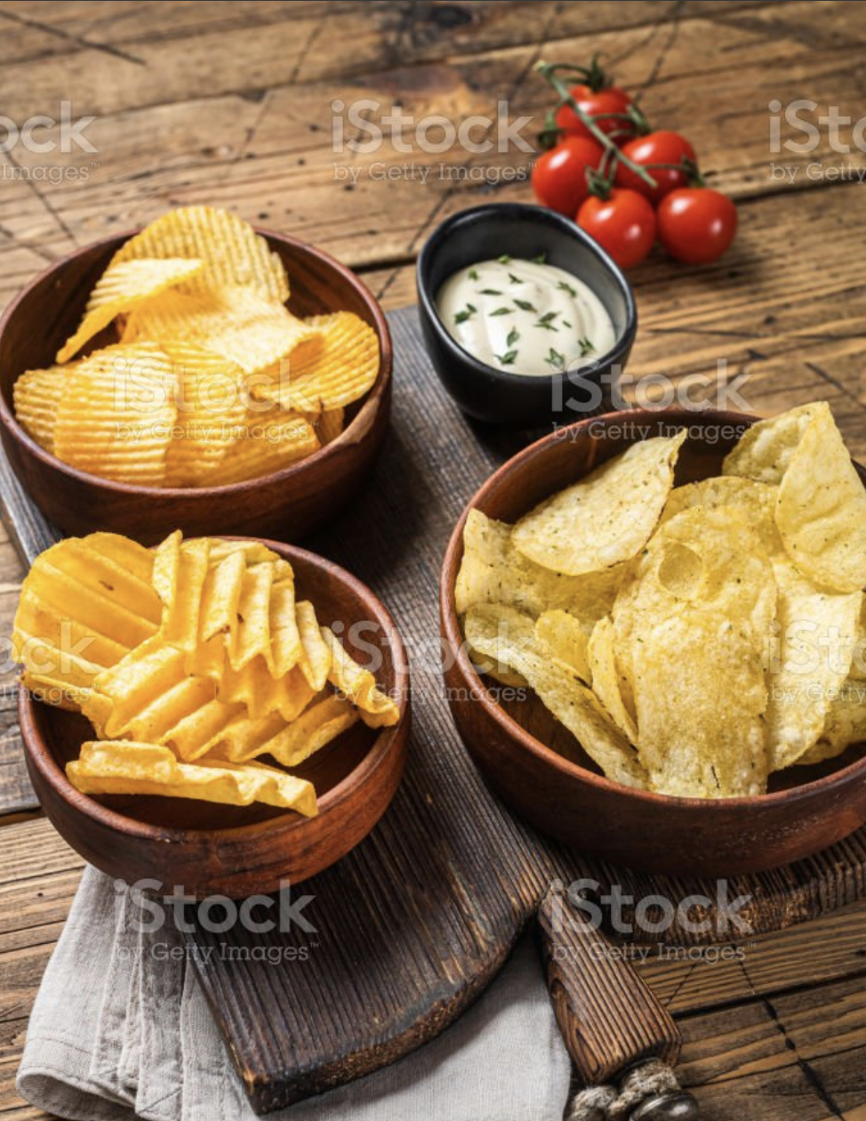
Image Courtesy
Istock photos
https://www.istockphoto.com/de/fotos/potatoes

